Slide 1
MEMORIAL DAY 9th of May
Sydorchuk Olha

Slide 2
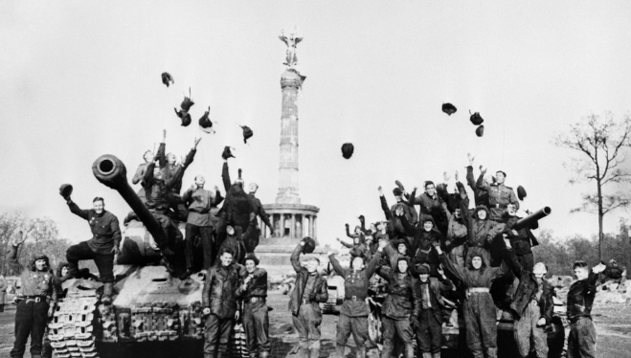
Victory Day / Memorial Day is a public holiday. It is a holiday that commemorates the surrender of Nazi Germany in 1945.

Slide 3
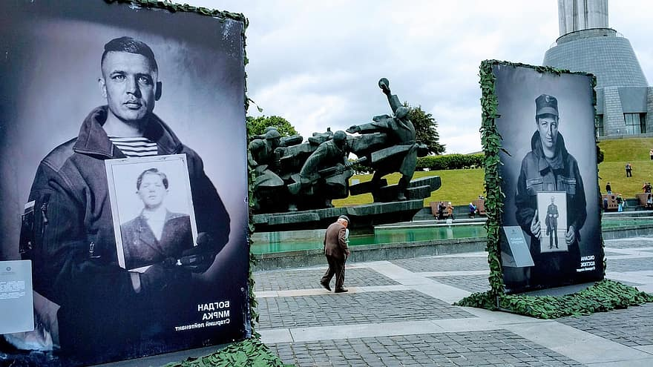
The celebration of Victory Day continued during subsequent years. The war became a topic of great importance in cinema, literature, history lessons at school, the mass media, and the arts. The ritual of the celebration gradually obtained a distinctive character with a number of similar elements: ceremonial meetings, speeches, lectures, receptions and fireworks.

Slide 4
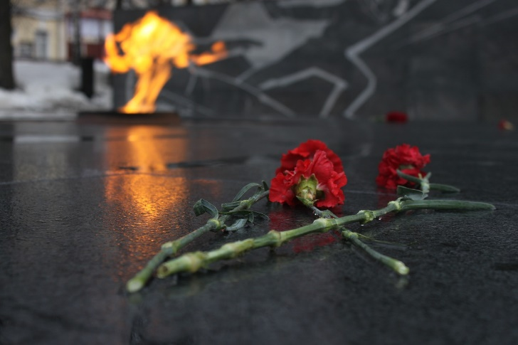
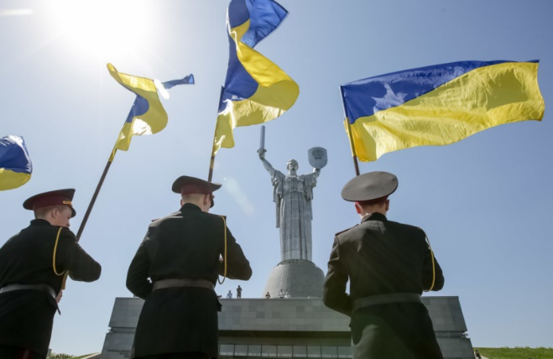
UKRAINE officially recognised 9 May from its independence in 1991 until 2013, where it was a non-working day. If it fell on a weekend the following Monday was non-working. The holiday was similarly celebrated there while the country was part of the Soviet Union. As of 2015, Ukraine officially celebrates Victory Day over Nazism in World War II on 9 May, per a decree of parliament. Additionally the term "Great Patriotic War" as a reference was replaced with "Second World War" in all Ukrainian legislation.

Slide 5
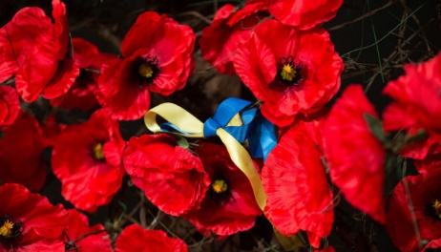
Since 15 May 2015 Communist and Nazi symbols are prohibited in Ukraine. Before 15 May 2015, Ukraine held military parades in the capital on Khreshchatyk in 1995, 2001, 2010, and 2011, and 2013

